Slide 1

Supply-Demand Factors Affecting U.S. Home Prices

Slide 2

Table of contents
Project Background
Analyzing Key Supply-Demand Factors Affecting U.S. Home Prices
Data Review and Analysis Approach
The data contains supply-demand factors that influence US home prices from past 20 years. This data are categorized into two datasets: Supply and Demand.
Exploratory Data Analysis
Correlation analysis, Pricing trend Analysis
Modelling
Regression modeling to identify key factors affecting the price and interpretation
Insights and Overall summary

Slide 3




Solution Process
Model Validation
The data collected for this assignment consist of two main files: Supply and Demand. These datasets contain quarterly data on key supply-demand factors that influence US home prices nationally.
Model Performance measure on
testing data
STEP
04
Model Preparation
STEP
03
Selecting the best model and train
the model on Training dataset.
Data Preparation and EDA
STEP
02
Correlation and trend analysis. Missing Values Treatment using mean imputation and scaling.
Data Collection & Understanding
STEP
01
Collecting the Data from appropriate sources and understanding the data .

Slide 4

Home price trend over years
The chart clearly shows that there is an increasing trend in house pricing over years.
Insights

Slide 5
Home Price vs Monthly houses supply
The monthly supply of new houses has a negative correlation with home prices. This means that increase in MSACSR could lead to a decrease in S&P/Case-Shiller U.S. National Home Price Index. This is because an increase in supply of new houses could lead to a decrease in demand which could lead to a decrease in prices.
Insights

Slide 6
Home Price vs pErmit
The number of new privately-owned housing units authorized has a moderate positive correlation with home prices. This suggests that the approval of the construction of more housing units tends to raise home prices. This is because a decrease in the supply of homes, workers and material causes an increase in price.
Insights

Slide 7
Home Price vs total construction spending
Total construction spending on residential projects has a strong positive correlation with home prices. This indicates that when there is higher spending on residential construction, it tends to push home prices upward.
Insights

Slide 8
Home Price vs Housing inventory
low supply or housing inventory will increase home prices due to high demand.
Insights

Slide 9
Home Price vs 30-Year Fixed Rate Mortgage Average
When mortgage rates are low, it can make it easier for people to buy homes, which can increase demand and drive-up home prices. Conversely, when mortgage rates are high, it can make it more difficult for people to buy homes, which can decrease demand and drive down home prices.
Insights

Slide 10
Home Price vs consumer sentiment
When consumers are confident about the economy, they are more likely to spend money on big-ticket items such as homes which can drive up home prices.
Insights

Slide 11
Home Price vs interest rates, discount rates
The relationship between interest rates and housing costs is like how lower interest rates can make it simpler for people to borrow money to buy homes, which can increase demand and drive-up prices.
Insights

Slide 12
Home Price vs median sales prices of houses sold
The Median Sales Price of Houses Sold for the United States, with half selling for more and half for less, is measured by the median sale price. Higher median sales prices are strongly associated with higher home prices.
Insights

Slide 13
Home Price vs GDP
When the overall economic output of the country, as represented by GDP, increases, it tends to be associated with higher home prices.
Insights

Slide 14
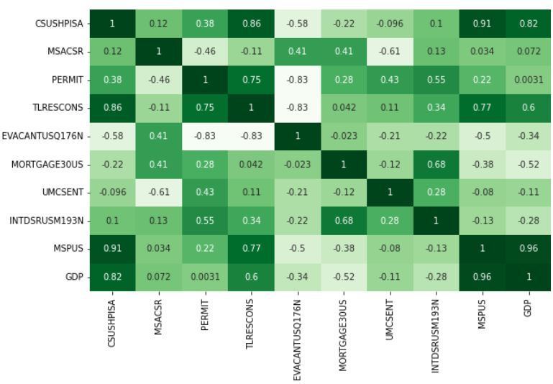

Correlation analysis
MSPUS (Median Sales Price of Houses Sold): There is a strong positive correlation (0.907924) relationship between the MSPUS and CSUSHPISA. Higher median sales prices are strongly associated with higher home prices.
TLRESCONS (Total Construction Spending: Residential): There is a strong positive correlation (0.861225) relationship between total construction spending on residential projects and CSUSHPISA. This suggests that higher construction spending is strongly associated with higher home prices.
GDP (Gross Domestic Product): There is a strong positive correlation (0.823877) relationship between GDP and CSUSHPISA. Higher GDP is strongly associated with higher home prices.
EVACANTUSQ176N (Housing Inventory Estimate: Vacant Housing Units): There is a moderate negative correlation (-0.584710) relationship between the estimated number of vacant housing units and CSUSHPISA. This indicates that a higher number of vacant housing units may exert downward pressure on home prices.
PERMIT (New Privately-Owned Housing Units Authorized): Positive : There is a moderate positive correlation (0.382217) relationship between the number of authorized housing units and CSUSHPISA. It indicates that a higher number of authorized housing units may have a positive influence on home prices.
All other variables 'MSACSR (Monthly Supply of New Houses)' , 'MORTGAGE30US (30-Year Fixed Rate Mortgage Average)','UMCSENT (University of Michigan: Consumer Sentiment)', (Interest Rates, Discount Rate)' h'INTDSRUSM193Nave weak positive or negative correlation with CSUSHPISA.

Slide 15
MODELS COMPARISION
MODEL 1
XGBoost
Regression
MODEL 2
Random
Forest
MODEL 3
Ridge Regression
Training | Testing
99%
Started with XGBoost regressor.
Training | Testing
99%
Used Random forest regressor.
Training | Testing
93% | 97%
Used ridge regression model
Accuracy
Out of 3 models Ridge regression was best with low prediction errors (MSE) and a high proportion of variance explained (R-squared score) and the other two models were over fitting and. since were interested in identify the key factors and their coefficients Ridge regression model results are considered best.

Slide 16
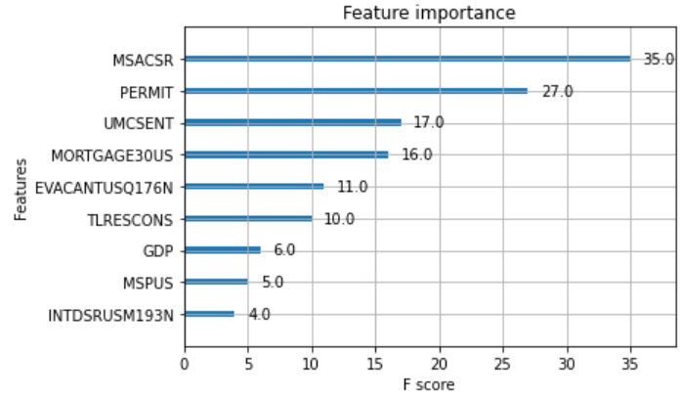
Model Coefficients and feature importance
Features | Coefficients
MSACSR | 7.661776
PERMIT | 0.01749
TLRESCONS | 0.000064
EVACANTUSQ176N | -0.001034
MORTGAGE30US | -13.97641
UMCSENT | -0.184943
INTDSRUSM193N | 3.740372
MSPUS | 0.000443
GDP | -0.002843
These coefficients provide insights into the direction and magnitude of the relationships between the features and the target variable. They can help understand which features have the most significant impact on the predicted home price index.
The coefficients provided insights into the importance of each feature and their impact on the predicted home price index.

Slide 17
Insights on Supply factors
The CSUSHPISA shows a positive association with the monthly supply of new homes (MSACSR). This implies that an increase in the supply of new homes may have a minor negative influence on housing prices.
The number of authorized housing units (PERMIT) has a moderately positive link with home values. This means that a greater number of authorized housing units may contribute to higher property prices. The reason for this is that when more houses are authorized for building, the supply of houses, materials, and labors is impacted.
Total construction spending on residential projects (TLRESCONS) has a strong positive correlation with home prices. This indicates that higher construction spending is strongly associated with higher home prices.
The estimated number of vacant housing units (EVACANTUSQ176N) has a moderate negative correlation with home prices. This suggests that a higher number of vacant housing units may exert downward pressure on home prices. Because houses supply increases leads to decrease in home prices.

Slide 18
Insights on Demand factors
The average interest rate MORTGAGE30US shows a weak negative correlation with home prices. This implies that higher mortgage rates are associated with slightly lower home prices.
Consumer sentiment (UMCSENT) has a weak negative correlation with home prices. Lower consumer sentiment is associated with slightly lower home prices.
Gross Domestic Product (GDP) has a strong positive correlation with home prices. Higher GDP is strongly associated with higher home prices.
The median sales price of houses sold (MSPUS) has a strong positive correlation with home prices. Higher median sales prices are strongly associated with higher home prices.

Slide 19
Thank you
basavanaiksanjay@gmail.com

